Slide 1
GH-100: GitHub Fundamentals - Administration basics and product features Part 1
GitHub Fundamentals - Administration basics and product features
- Part 1
Notes:
https://learn.microsoft.com/en-us/training/paths/github-administration-products/

Slide 2
Module 4: Maintain a secure repository by using GitHub best practices
Module 4: Maintain a secure repository by using GitHub best practices
Notes:
Title: Module 4: Maintain a secure repository by using GitHub best practices
Learning Objectives:
By the end of this unit, you'll be able to:
Identify the tools and GitHub features to establish a secure development strategy.
Enable vulnerable dependency detection for private repositories.
Detect and fix outdated dependencies with security vulnerabilities.
Automate the detection of vulnerable dependencies with Dependabot.
Add a security policy with a SECURITY.md file.
Remove a commit exposing sensitive data in a pull request.
Remove historical commits exposing sensitive data deep in your repository.
Module Units
Introduction - 2 min
How to maintain a secure GitHub repository - 8 min
Automated security - 6 min
Exercise - Secure your repository's supply chain - 15 min
Module assessment - 3 min
Summary - 1 min

Slide 3
Introduction
In this unit, you will learn to apply GitHub’s automated security tools—branch protection, code scanning, Dependabot, and secret scanning—to enforce robust, friction-free protection across your development lifecycle.
By the end of this unit, you'll be able to:
Recognize the importance of securing your repository and shifting left in the development lifecycle.
Identify the tools, GitHub features, and best practices to establish a secure development strategy.
Keep sensitive files out of your repository by applying the use of a .gitignore file.
Identify how to detect and fix outdated dependencies with security vulnerabilities.
Recognize advanced security features such as code scanning and secret scanning.
Notes:
Security isn’t an afterthought—it’s woven into every phase of the software-development lifecycle, from writing code to deploying infrastructure. Today, we’re focusing on the processes and workflows that keep your repository safe without turning it into a fortress that scares away contributors.
Imagine you’re responsible for a mission-critical GitHub repo: you want airtight protection, but you also want your team—and the open-source community—to feel welcome. Strict security policies can introduce friction, slowing down development and collaboration.
GitHub’s suite of automated security features—like branch protection, code scanning, Dependabot, and secret scanning—helps you strike the right balance. These tools enforce robust safeguards under the hood, so your contributors can keep shipping code without stumbling over manual gates or complex workflows.
By the end of this module, you’ll be able to:
Recognize why securing your repository early—‘shifting left’—is critical to catching vulnerabilities before they reach production.
Identify GitHub’s security tools and best practices, from .gitignore to automated dependency updates, that form the backbone of a proactive defense strategy.
Keep sensitive files out of your repo by mastering .gitignore patterns and workflows.
Detect and remediate vulnerable dependencies with Dependabot and manual review.
Leverage advanced features like code scanning and secret scanning to surface hidden risks and protect your secrets.
These skills will empower you to build a secure development pipeline that guards your code without slowing down your team.

Slide 4
How to maintain a secure GitHub repository
Here, we discuss some of the essential security tools and techniques available to GitHub repository administrators.
Note: The following content doesn't cover the fundamentals of writing secure code, but rather important security considerations, tools, and features to use within a GitHub repository.
Notes:
Maintaining a secure repository goes beyond writing safe code—it’s about leveraging GitHub’s built-in features to harden your workflows and guard your assets.
Over the next few minutes, we’ll explore a toolkit of essential practices you can apply right inside GitHub to keep your project resilient against threats while keeping contributors moving swiftly.

Slide 5
The importance of a secure development strategy
Application security is important. News services frequently carry stories about some breach of a company's systems and private company and customer data that was stolen.
So, what are the issues to think about when planning a secure development strategy? Clearly, we need to protect information from being disclosed to people that shouldn't have access to it, but more importantly, we need to ensure that information is only altered or destroyed when it's appropriate.
We need to make sure we properly authenticate who's accessing the data and that they have the correct permissions to do so. Through historical or archival data or logs, we need to be able to find evidence when something is wrong.
Notes:
Every week, we read about another company hit by a security breach—customer records exposed, intellectual property stolen, reputations tarnished. In today’s environment, application security isn’t optional; it’s a core part of delivering reliable software.
We need to make sure we properly authenticate who's accessing the data and that they have the correct permissions to do so. Through historical or archival data or logs, we need to be able to find evidence when something is wrong.

Slide 6



The importance of a secure development strategy
There are many aspects to building and deploying secure applications. Here are three things to consider:
There's a general knowledge problem:
Code must be created correctly and securely:
Applications must comply with rules and regulations:
Many developers and other staff members assume they understand security, but they don't. Cybersecurity is a constantly evolving discipline.
A program of ongoing education and training is essential.
We need to be sure that the code is created correctly and securely implements the required features.
We also need to make sure that the features were designed with security in mind.
We need to make sure that the code complies with required rules and regulations.
We have to test for compliance while building the code and then retest periodically, even after deployment.
Notes:
Security isn’t a one‑and‑done topic—it’s a rapidly evolving field that even experienced developers can find challenging. That’s why creating a culture of ongoing education is vital. Offer regular training sessions, share security bulletins, and encourage your team to pursue certifications or attend conferences. By keeping everyone’s knowledge fresh, you reduce risky assumptions and empower your staff to recognize and address new threats as they emerge.
Writing code that simply works isn’t enough; it must also be built with security in mind from the very beginning. During the design phase, apply threat modeling to identify potential attack surfaces and choose secure architectures. As you develop, adopt practices like input validation, output encoding, and the principle of least privilege. Integrate static analysis and code‑review checklists focused on security to catch vulnerabilities early—before they ever reach a production environment.
Different industries impose strict rules on how data is handled, stored, and transmitted. You need to bake compliance checks into your CI/CD pipeline so that every build is validated against relevant standards (PCI‑DSS, HIPAA, GDPR, etc.). But compliance isn’t a one‑time milestone; it requires periodic retesting and audits to ensure that new dependencies, configuration changes, or feature additions haven’t introduced non‑compliant behavior. Treat compliance as an ongoing process, not a checkbox at release time.

Slide 7
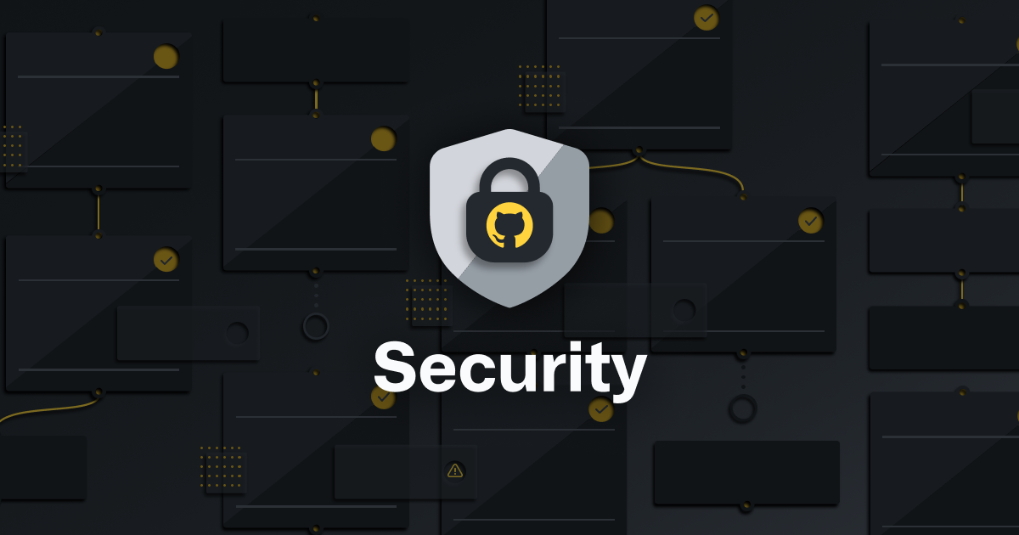
Security at every step
Security isn't something you can just add later to an application or a system. Secure development must be part of every stage of the software-development life cycle. This concept is even more important for critical applications and those applications that process sensitive or highly confidential information.
In practice, to hold teams accountable for what they develop, processes need to shift left or be completed earlier in the development lifecycle. By moving steps from a final gate at deployment time to an earlier step, fewer mistakes are made, and developers can move more quickly.
Application-security concepts weren't a focus for developers in the past. Apart from the education and training issues, it's because their organizations emphasized fast development of features.
Overall, when the time for rework is taken into account, adding security to your DevOps practices earlier in the development lifecycle allows development teams to catch issues earlier. Catching issues earlier can actually reduce the overall time it takes to develop quality software.
Shifting left is a process change, but it isn’t a single control or specific tool. It’s about making all of your security more developer-centric and giving developers security feedback where they are.
Notes:
First, let’s talk about shifting left. Instead of waiting until deployment to run security tests, we integrate them into design reviews, pull-request checks, and CI/CD pipelines. By catching issues earlier—during development rather than at release—you reduce costly rework and keep your delivery cadence fast.
Next, consider the DevOps synergy. With modern build tools and platforms, security scans—static analysis, dependency checks, secret detection—become automated steps in your existing workflows. That means developers get actionable feedback where they already work, turning security from a specialist task into a natural part of daily coding.
Finally, this is as much a culture shift as it is a technical one. Train your teams regularly, celebrate secure-by-design wins, and make security metrics visible alongside your build and test dashboards. When everyone owns security from day one, you protect your most critical—and often most sensitive—applications without sacrificing speed or collaboration.

Slide 8
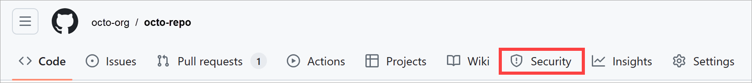
Security tab features
GitHub offers security features that help keep data secure in repositories and across organizations. To locate the security tab:
On GitHub.com, go to the repository's main page.
Under the repository name, select Security.
From the Security tab, you can add features to your GitHub workflow to help avoid vulnerabilities in your repository and codebase.
Notes:
Every GitHub repository includes a Security tab that serves as your launchpad for built‑in security tools.
To find it, navigate to your repository’s main page and click Security just below the repo name.
Once you’re in the Security tab, you gain access to four core tools that help you detect and manage vulnerabilities directly within your repository.

Slide 9
Security tab features (continued)
Security Policies (SECURITY.md)
Security Advisories
A SECURITY.md file provides a standardized way to inform contributors about the security policies of a repository. It includes guidelines on how to report security vulnerabilities responsibly. This ensures that security issues are addressed in a structured manner, facilitates responsible disclosure, and enhances transparency among contributors and users.
Security advisories provide a private space for maintainers to discuss, resolve, and document security vulnerabilities before public disclosure. This protects users from security risks by handling vulnerabilities discreetly and ensures responsible coordination of security patches.
Dependabot Security Alerts
Code Scanning
Dependabot continuously monitors dependencies and alerts repository owners when vulnerabilities are found in third-party libraries. Automated updates ensure that dependencies remain secure and up-to-date, reducing the likelihood of security breaches due to outdated packages.
GitHub provides built-in code scanning using static analysis tools like CodeQL to identify potential security vulnerabilities before deployment. This enhances code quality by detecting security flaws early in the development cycle and ensuring adherence to secure coding practices.
For more information, see GitHub security features.
Notes:
These four core tools include:
Security Policies By adding a SECURITY.md file to your repo, you publish clear instructions on how contributors and users can report security issues—ensuring you receive vulnerability reports through the right channels.
Dependabot Alerts Dependabot continuously scans your dependency graph for known vulnerabilities or malware. When it finds a risk, GitHub notifies you so you can review and update your dependencies before they’re exploited.
Security Advisories Use private advisories to coordinate the disclosure and remediation of vulnerabilities. You can discuss fixes with your team, draft patches, and then publish the advisory to inform your users—all without exposing details prematurely.
Code Scanning Powered by tools like CodeQL, code scanning analyzes your source for security flaws and errors. The results appear in the Security tab and in pull requests, letting you triage findings and fix issues as part of your standard development workflow.
For full details on configuring and using these capabilities, refer to the GitHub security features documentation.

Slide 10
Communicate a security policy with SECURITY.md
GitHub's community benefits are substantial, but they also carry potential risks. The fact that anyone can propose bug fixes publicly comes with certain responsibilities.
The most important is the responsible disclosure of information that could lead to security exploits before their underlying bugs can be fixed. Developers looking to report or address security issues look for a SECURITY.md file in the root of a repository in order to responsibly disclose their concerns. Providing guidance in this file ultimately speeds up the resolution of these critical issues.
To learn more about SECURITY.md, see Adding a security policy to your repository.
Notes:
Next, we explore some of these features and learn ways to distribute security and operational responsibilities across all phases of the software-development lifecycle.
GitHub’s open collaboration model empowers anyone to propose fixes, but it also means security reports could be exposed publicly if there isn’t a clear process.
Placing a SECURITY.md file in your repository root signals to researchers exactly how to submit vulnerability reports responsibly—what contact to use, what information to include, and how you’ll handle disclosure. By providing this guidance upfront, you encourage private, coordinated reporting and dramatically speed up the time it takes to resolve critical issues.
Remember, developers and auditors alike look for that SECURITY.md first—so make it a priority in every repository you maintain. For a complete template and best practices, see “Adding a security policy to your repository.

Slide 11
GitHub Security Advisories
GitHub Security Advisories allow repository maintainers to privately discuss and fix a security vulnerability in a project. After repository maintainers collaborate on a fix, they can publish the security advisory to publicly disclose the security vulnerability to the project's community.
By publishing security advisories, repository maintainers make it easier for their community to update package dependencies and research the consequences of the security vulnerabilities. GitHub stores the published advisories in the Common Vulnerabilities and Exposures (CVE) list. This list is used for automatically notifying affected repositories that use software that has a listed vulnerability.
For more information, see About repository security advisories.
Notes:
GitHub Security Advisories give you a private channel to collaborate on fixes before any public disclosure. As a maintainer, you can draft an advisory directly in your repo—discuss the vulnerability, propose patches, and iterate securely with your team without tipping off potential attackers.
Once you have a solution ready, you publish the advisory to inform your community. GitHub automatically registers the advisory in the Common Vulnerabilities and Exposures (CVE) list, which drives automated notifications to any repositories that depend on the affected code.
This streamlined workflow not only helps everyone update vulnerable dependencies promptly, but also provides a single source of truth about the impact and remediation steps for the vulnerability. For the full step‑by‑step process, see “About repository security advisories.

Slide 12
Keep sensitive files out of your repository with .gitignore
It's easy for developers to overlook files included in a commit. Sometimes these overlooked files are benign, such as intermediate build files. However, there's always the risk that someone might inadvertently commit sensitive data.
# User-specific files - Ignore all files ending in ".suo"
*.suo
# Mono auto generated files - Ignore all files starting with "mono_crash."
mono_crash.*
# Build results - Ignore all files in these folders found at any folder depth
[Dd]ebug/
[Rr]elease/
x64/
x86/
# Root config folder - Ignore this directory at the root due to leading slash
# Removing the slash would ignore "config" directories at all depths
/config
# Ignore intermediate JS build files produced during TypeScript build at any
# folder depth under /Web/TypeScript. This won't ignore JS files elsewhere.
/Web/TypeScript/**/*.js
For example, someone could commit an API key or private configuration data that a malicious actor could use. One technique to help avoid this risk is to build and maintain .gitignore files. These files instruct client tools, such as the git command line utility, to ignore paths and patterns when aggregating files for a commit.
The following sample illustrates some of the common use cases for ignoring files:
Notes:
Accidentally committing sensitive or machine‑specific files—like API keys, user settings, or build artifacts—can expose your project to security risks or simply clutter your history. A well‑maintained .gitignore tells Git exactly which files and directories to skip when you stage changes, preventing these mistakes before they happen.
In the example:
*.suo ignores user‑specific Visual Studio files.
mono_crash.* skips auto‑generated crash logs from Mono.
[Dd]ebug/, [Rr]elease/, x64/, and x86/ omit build output folders at any depth.
A leading slash in /config confines ignoring to the root config directory—protecting private configuration without hiding other folders named config.
The /Web/TypeScript/**/*.js pattern ignores intermediate JavaScript files produced by TypeScript builds in a specific path, while still tracking .js elsewhere.
By tailoring your .gitignore to your project’s tools and secret files, you keep your repository clean, secure, and focused on the source code that matters.

Slide 13
Keep sensitive files out of your repository with .gitignore (continued)
Your repository might include multiple .gitignore files. Settings are inherited from parent directories, with overriding fields in new .gitignore files taking precedence over parent settings for their folders and subfolders. It's significant effort to maintain the root .gitignore file, although adding a .gitignore file into a project directory can be helpful when that project has specific requirements that are easier to maintain separately from the parent, such as files that should not be ignored.
To learn more about .gitignore, see Ignoring files.
Also check out the collection of starter .gitignore files offered for various platforms in the gitignore repository.
Notes:
In larger repositories, you’re not limited to a single .gitignore at the root—Git will honor additional .gitignore files placed in subdirectories, with their patterns taking precedence over parent rules for that folder and everything beneath it.
While maintaining one monolithic root .gitignore can become unwieldy as projects grow, sprinkling targeted .gitignore files into individual module directories lets you capture project‑specific exclusions—whether it’s test artifacts, local configs, or generated files—without cluttering the global ignore list.
This hierarchical approach keeps each component’s ignore rules close to the files they affect, making maintenance simpler and reducing the risk of accidentally ignoring or committing the wrong files. If you’re just getting started, GitHub’s “gitignore” repository offers a rich set of boilerplates for popular languages and platforms that you can customize per directory.
For a deep dive on syntax and best practices, check out the official “Ignoring files” documentation

Slide 14
Remove sensitive data from a repository
While .gitignore files can be useful in helping contributors avoid committing sensitive data, they're just a strong suggestion. Developers can still work around a .gitignore file to add files if they're motivated enough, and sometimes files might slip through because they don't meet the .gitignore file configuration. Project participants should always be on the lookout for commits that contain data that shouldn't be included in the repository or its history.
Important: You should assume that any data committed to GitHub at any point has been compromised. Simply overwriting a commit isn't enough to ensure the data won't be accessible in the future. For the complete guide to removing sensitive data from GitHub, see Removing sensitive data from a repository.
Notes:
Even the best .gitignore rules aren’t foolproof—developers can override them, or patterns might miss edge‑case files. Whenever sensitive data does land in your repository, you must treat it as compromised and remove it from every commit history, not just overwrite the latest version.
Start by identifying all occurrences of the secret—whether it’s an API key, certificate, or password—in your Git history. Then use a history‑rewriting tool like the BFG Repo-Cleaner or git filter-repo to scrub the data from every commit. After you’ve rewritten history, force‑push the cleaned branches, rotate any exposed credentials immediately, and notify collaborators so they can reclone the sanitized repository.
This process ensures that the sensitive data is truly purged from your repo’s history. For a detailed, step‑by‑step guide, see the “Removing sensitive data from a repository” documentation.

Slide 15
Branch protection rules
You can create a branch protection rule to enforce certain workflows for one or more branches. For example, you can require an approving review or passing status checks for all pull requests merged into the protected branch.
You can use the workflows that protect the branch to:
Run a build to verify the code changes can be built;
Run a linter to check for typos and conformation to the internal coding conventions;
Run automated tests to check for any behavior changes of the code;
And so on.
Notes:
Branch protection rules let you define guardrails around critical branches—such as main or release branches—to ensure that only vetted changes can be merged.
By enabling protections, you can require that every pull request has an approving review, passes specified status checks, or meets other workflow gates before merge. This prevents accidental direct pushes or merges that could introduce bugs or security issues into your primary code line.
Under the hood, protected workflows can automatically run your CI pipeline—building the code, linting for style and typos, executing unit and integration tests, and any other custom checks you define. If any of these checks fail, the pull request can’t be merged until the issues are resolved.
This approach shifts quality assurance earlier in the process, giving developers fast feedback and maintaining the integrity and reliability of your protected branches.

Slide 16
Add a CODEOWNERS file
By adding a CODEOWNERS file to your repository, you can assign individual team members or entire teams as code owners to paths in your repository. These code owners are then required for pull-request reviews on any changes to files in a path for which they're configured.
You can create the CODEOWNERS file in either the root of the repository or in the docs or .github folder.
# Changes to files with the js extensions need to be reviewed by the js-owner user/group:
*.js @js-owner
# Changes to files in the builds folder need to be reviewed by the octocat user/group:
/build/ @octocat
Notes:
By introducing a CODEOWNERS file into your repository, you designate the experts responsible for specific parts of your codebase—whether individuals or entire teams.
Place this file in the root, .github/, or docs/ folder, then map file paths or patterns to GitHub usernames or team handles.
Once configured, any pull request touching those paths automatically requests reviews from the listed owners and blocks merging until they approve.
This ensures that every change is vetted by the right people, maintaining code quality and domain expertise without adding manual review coordination.

Slide 17
Automated security
Here, we discuss some ways you can automate security checks in a repository that are available to GitHub repository administrators.
Notes:
Now, let’s discuss some ways you can automate security checks in a repository that are available to GitHub repository administrators.

Slide 18
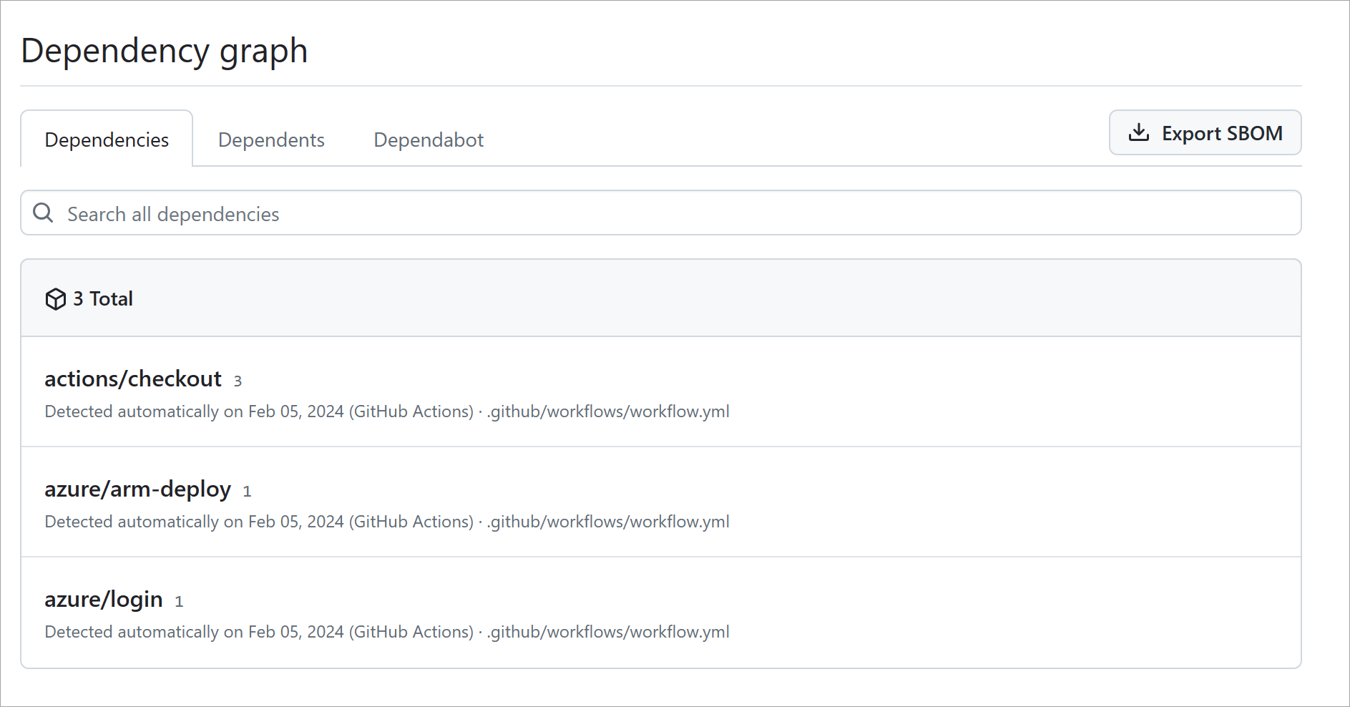
Detect and fix outdated dependencies with security vulnerabilities
Virtually every project these days takes dependencies on external packages. While these components can offer substantial benefits in productivity, they can introduce other security risks. Staying on top of these packages and their vulnerability status can be time-consuming, especially given how each dependency might have its own dependencies that can become difficult to track and maintain. Fortunately, GitHub provides features that reduce this workload.
For the list of supported dependency manifests, see About the dependency graph.
Repository dependency graphs
One default feature every repository includes is dependency graphs. GitHub scans common package manifests, such as package.json, requirements.txt, and others. These graphs allow project owners to recursively track all of the dependencies their project relies on.
Notes:
Let’s start with one of the most common sources of vulnerabilities: outdated dependencies. Most modern software relies on third-party packages, and while those can speed up development, they also introduce security risks.
GitHub helps manage this risk by automatically generating a dependency graph. This graph scans common package files like package.json or requirements.txt and visually maps out all your project's dependencies, including indirect ones. This visibility helps teams keep track of what’s in their codebase.

Slide 19
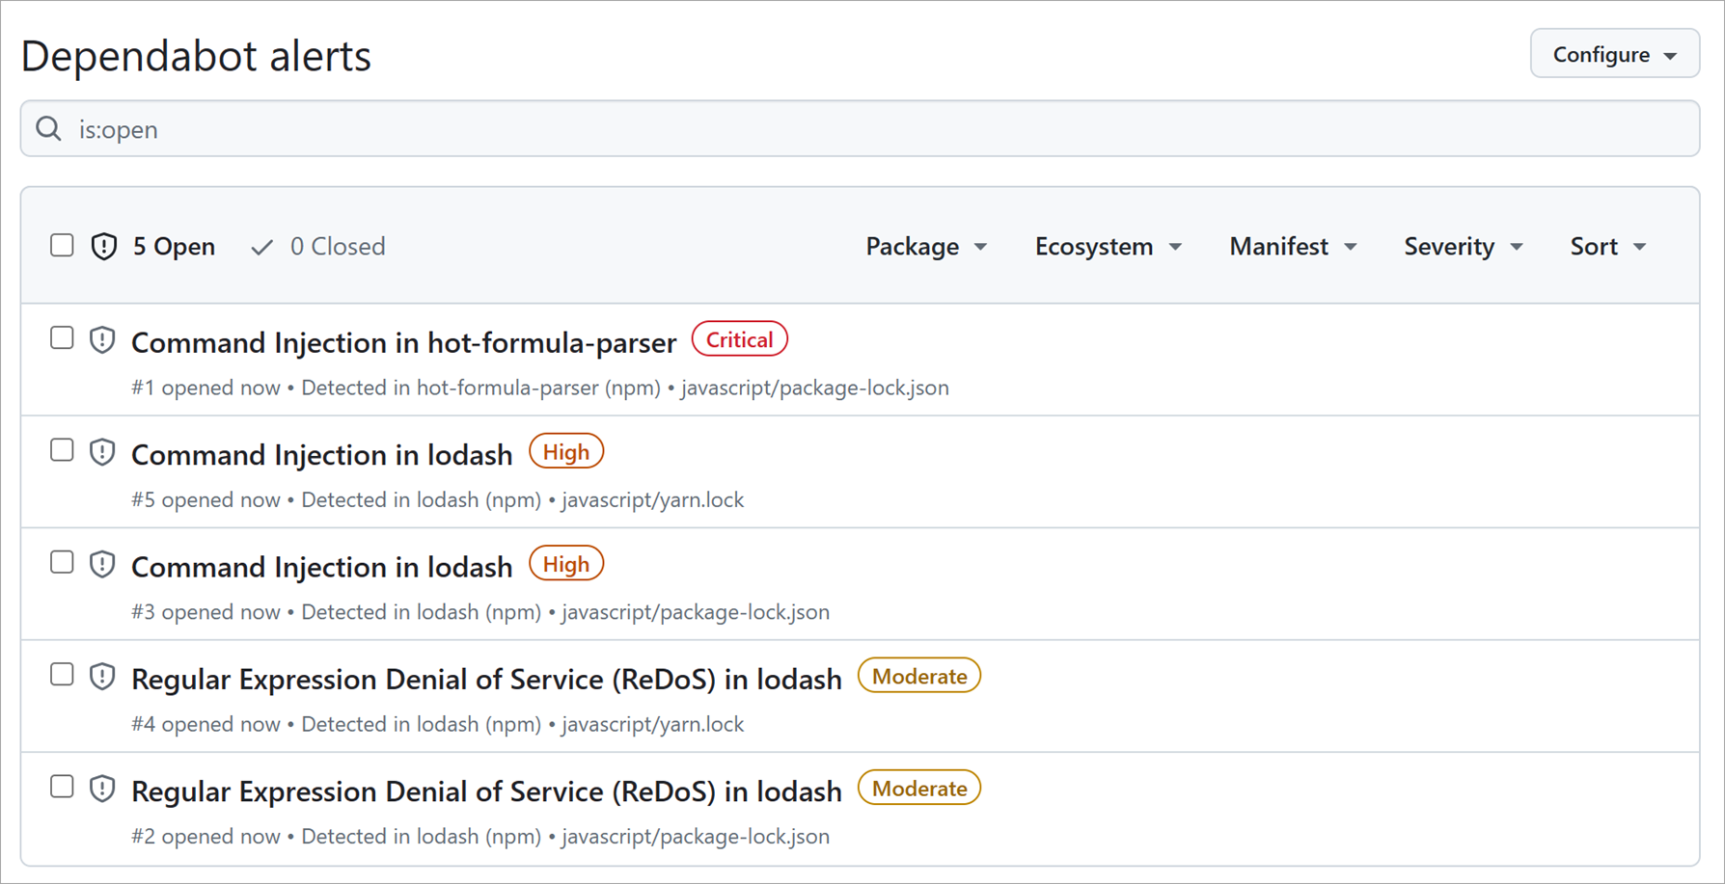
Detect and fix outdated dependencies with security vulnerabilities (continued)
Dependabot alerts
Automated dependency updates with Dependabot
Even with a visual dependency graph, it can still be overwhelming to stay on top of the latest security considerations for every dependency a project has. To reduce this overhead, GitHub provides Dependabot alerts that watch your dependency graphs for you. It then cross-references target versions with versions on known vulnerability lists. When a risk is discovered,
A dependency alert can lead to a project contributor bumping the offending package reference to the recommended version and creating a pull request for validation. Wouldn't it be great if there was a way to automate this effort? Well, good news! Dependabot does just that. It scans for dependency alerts and creates pull requests so that a contributor can validate the update and merge the request.
To learn more about Dependabot's flexibility, see Configuring Dependabot security updates.
the project is alerted. Input for the analysis comes from GitHub Security Advisories.
Notes:
To stay on top of these, GitHub provides Dependabot alerts.
These alerts automatically flag any dependencies that match known vulnerabilities in the GitHub Security Advisory database.
And to make life easier, GitHub also provides automated dependency updates.
When Dependabot detects a risk, it can open a pull request to bump the dependency to a safer version.
All you need to do is review and merge.
It’s a proactive way to keep your projects secure with minimal overhead.

Slide 20
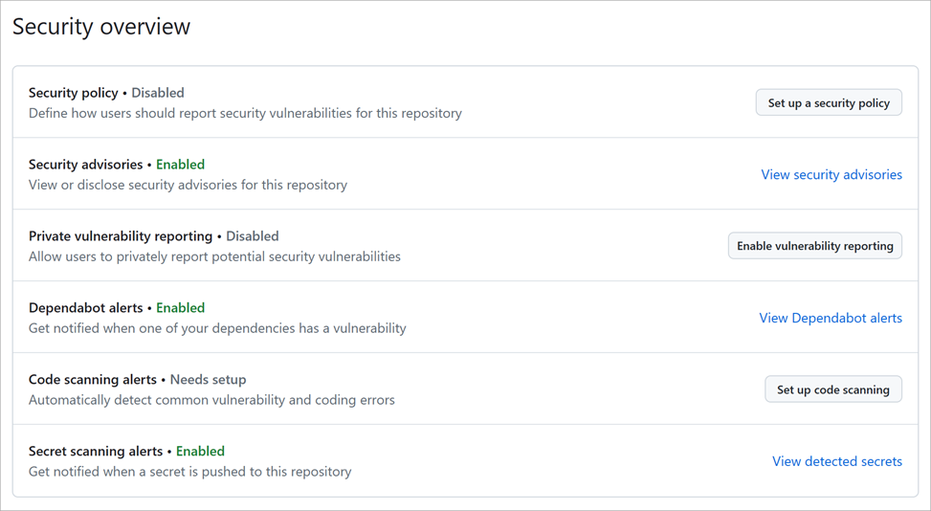
Detect and fix outdated dependencies with security vulnerabilities (continued)
Automated code scanning
Similar to how Dependabot scans your repository for dependency alerts, you can use code scanning to analyze and find security vulnerabilities and errors in the code in a GitHub repository. Code scanning has several benefits. You can use it to find, triage, and prioritize fixes for existing problems or potential security vulnerabilities. It's also useful to help prevent developers from introducing any new security problems into the code. You can enable code-scanning alerts and workflows in the security tab of a GitHub repository:
Notes:
Let’s shift from managing dependencies to analyzing the code itself. Automated code scanning in GitHub helps identify security vulnerabilities and common coding errors within your repository.
Similar to how Dependabot scans for dependency risks, code scanning checks your actual codebase. This is a proactive approach—not only does it help identify existing problems, but it also helps prevent developers from introducing new ones.

Slide 21
Secret scanning
Another automated scanning feature within a GitHub repository is secret scanning. Similar to the previous security scanning features, secret scanning looks for known secrets or credentials committed within the repository. This scanning is done to prevent the use of fraudulent behavior and to secure the integrity of any sensitive data. By default, secret scanning occurs on public repositories and you can enable secret scanning on private repositories by repository administrators or organization owners.
When secret scanning detects a set of credentials, GitHub notifies the service provider who issued the secret. The service provider validates the credential. Then, it decides whether they should revoke the secret, issue a new secret, or reach out to you directly. The action depends on the associated risks to you or the service provider.
Learn more about Secret scanning for public and private repositories.
Notes:
Let’s talk about a security risk that’s all too common—accidentally committing secrets to a repository. This could be anything from API keys, authentication tokens, passwords, or access credentials that somehow made it into a commit.
Now, in a fast-moving dev environment, mistakes happen. Someone forgets to add a .env file to .gitignore, or hardcodes a key just to get something working. Before you know it, it’s in version control.
That’s where GitHub's secret scanning steps in. Think of it as a watchdog. It scans your repository for known patterns that look like secrets—things like AWS keys, Slack tokens, or private credentials. And it works automatically.
Here’s how it works:
On public repositories, secret scanning is enabled by default—so you're already protected.
For private repositories, you or an organization admin need to manually enable it through the Security & analysis settings.
Now, when GitHub detects a secret, it doesn’t just alert you. It can also notify the service provider—for example, AWS or GitHub itself—depending on the credential type. The provider then decides the next steps: revoke it, replace it, or contact you directly. That’s a powerful escalation mechanism that stops problems before they grow.
Secret scanning isn’t just about finding issues—it’s about responding to them quickly, with minimal impact.
So if you manage a repo—especially one used in production—it’s critical that this feature is turned on for private repos too. It’s your safety net against accidental exposure of sensitive information.

Slide 22


Exercise - Secure your repository's supply chain
In this exercise, we secure your repository's supply chain through Dependency graph, Dependency alerts, Dependency security updates, and Dependency version updates.
This GitHub exercise is graded automatically once you attempt a solution to the challenge. The results of your actions and your helpful feedback are provided in real time within the grade-learner workflow logs.
Here are some helpful tips before you begin the exercise:
Read the Welcome section of the README file in the exercise's repository to understand more about the exercise.
Follow the steps provided in the How to start this course section to successfully complete the exercise.
To see the results of your exercise, navigate to your cloned repository's Actions tab and select the most recent run on the Grading workflow.
Stuck on what to do? Revisit the content in the last unit or check out the README file in the exercise's repository.
Notes:
In this hands‑on exercise, you’ll put everything we’ve learned about dependency security into practice. You’ll work through four key tasks:
Explore the Dependency Graph to visualize every direct and transitive library your project relies on.
Enable Dependabot Alerts so GitHub notifies you when a vulnerable dependency is detected.
Configure Dependency Security Updates to have GitHub automatically generate pull requests that patch known vulnerabilities.
Review and Merge Dependency Version Updates to keep your supply chain up to date.
When you click Start the exercise on GitHub, you’ll be directed to a template repository that guides you step by step. The built‑in grading workflow will validate your work in real time—just check the Actions tab under the “Grading” workflow to see your progress and feedback.
Before you begin, open the exercise’s README and read the Welcome section to understand the challenge context. Follow the “How to start this course” instructions exactly to ensure the grader can validate your changes. If you get stuck, revisit the content in the last unit or refer back to the README for guidance.

Slide 23
Exercise - Secure your repository's supply chain (continued)
There's a grading script under .github/workflows/grading.yml. You don't need to modify this workflow to complete this exercise. Altering the contents in this workflow can break the exercise's ability to validate your actions, provide feedback, or grade the results.
This exercise is a challenge based on content covered in this module, and there could be more than one way to successfully complete the exercise. If you get stuck, revisit previous content in this module or navigate to some of the other resources provided.
When you finish the exercise in GitHub, return here for your next unit.
Start the exercise on GitHub.
Notes:
Before you begin, please note that the .github/workflows/grading.yml file contains the automated grading script for this exercise. Do not modify this workflow—any changes may prevent the exercise from validating your work correctly.
Remember, there’s often more than one valid way to meet the challenge requirements. If you find yourself stuck, revisit the module content or the exercise README for hints and instructions.
Once you’ve completed the tasks and seen your grading results in the Actions tab, return here to proceed to the next unit.
Let’s secure your repository’s supply chain—click Start the exercise on GitHub when you’re ready!

Slide 24
Knowledge Checks
Notes:
Great work making it to the end of this module!
Now it’s time for a quick knowledge check to reinforce what you’ve learned.
You’ll see three questions that cover the key concepts we discussed—authentication methods, repository security controls, and administrative best practices.
Take your time to read each scenario carefully and select the best response based on GitHub’s recommended workflows.
These questions aren’t meant to trick you, but to help you identify any areas you might want to review before moving on.
Let’s dive in!

Slide 25
Knowledge Check:Maintain a secure repository by using GitHub best practices
1 of 3
What's the best way to make sure you're integrating the most secure versions of your project dependencies?
Configure your package files to always use the latest versions of dependencies.
Check each project's security details closely before adding it to your dependencies by confirming its version status across multiple advisory sites.
Enable Dependabot for your repository.
© Copyright Microsoft Corporation. All rights reserved.
Notes:
1. What’s the best way to make sure you’re integrating the most secure versions of your project dependencies?
a. Configure your package files to always use the latest versions of dependencies.
Explanation: Pinning to “latest” can introduce breaking changes and doesn’t guarantee security patches are applied in a controlled way.
b. Check each project’s security details closely before adding it to your dependencies by confirming its version status across multiple advisory sites.
Explanation: Manual checks are error‑prone, time‑consuming, and easy to overlook when new vulnerabilities are discovered.
c. Enable Dependabot for your repository.
Explanation: Dependabot continually scans your dependency graph for known vulnerabilities and automatically opens pull requests to update to secure versions.
Correct answer: c

Slide 26
Knowledge Check:Maintain a secure repository by using GitHub best practices
2 of 3
Suppose one of your source projects relies on secrets kept in a folder called .secrets. You would like to make sure that the files kept in this folder on development machines aren't inadvertently committed to the repository. Which of these files best helps enforce this policy?
SECURITY.md
.gitignore
CONTRIBUTING.md
© Copyright Microsoft Corporation. All rights reserved.
Notes:
Suppose one of your source projects relies on secrets kept in a folder called .secrets. You would like to make sure that the files kept in this folder on development machines aren’t inadvertently committed to the repository. Which of these files best helps enforce this policy?
a. SECURITY.md
Explanation: Defines your vulnerability‑reporting process but does not prevent files from being committed.
b. .gitignore
Explanation: Instructs Git to ignore specified paths (like .secrets/), preventing those files from being staged or committed.
c. CONTRIBUTING.md
Explanation: Provides guidelines for contributors but does not technically enforce exclusion of files.
Correct answer: b

Slide 27
Knowledge Check:Maintain a secure repository by using GitHub best practices
3 of 3
What does secret scanning do?
Looks for known secrets or credentials committed within the repository.
Analyzes and finds security vulnerabilities and errors in the code in a GitHub repository.
Secret scanning uses CodeQL to query your code as data.
© Copyright Microsoft Corporation. All rights reserved.
Notes:
What does secret scanning do?
a. Looks for known secrets or credentials committed within the repository.
Explanation: Secret scanning detects API keys, tokens, and other sensitive strings in your commit history and files.
b. Analyzes and finds security vulnerabilities and errors in the code in a GitHub repository.
Explanation: That describes code scanning (e.g., CodeQL), not secret scanning.
c. Secret scanning uses CodeQL to query your code as data.
Explanation: Secret scanning is a separate feature and does not rely on CodeQL queries.
Correct answer: a

Slide 28
Summary
In this module, we talked about the importance of securing and maintaining a GitHub repository.
You learned about:
The importance of securing your repository and shifting left in the development lifecycle.
Security features and best practices within a GitHub repository.
Detection of outdated dependencies with security vulnerabilities.
How to add a .gitignore file to a repository.
Advanced security features such as code scanning and secret scanning.
Now that you're familiar with security best practices, learn to Automate DevOps processes by using GitHub Apps.
Now that you're familiar with the basics of GitHub, learn to Upload your project by using GitHub best practices.
Learn more
Here are some links to more information on the topics we discussed in this module.
Adding a security policy to your repository
Ignoring files
Removing sensitive data from a repository
Viewing and updating Dependabot alerts
Dependabot official site
Security apps on GitHub Marketplace
Notes:
In this module, you learned why securing your GitHub repository is critical and how shifting security checks left in the development lifecycle helps catch issues early
We reviewed essential security controls—like .gitignore files to prevent accidental commits, Dependabot alerts and dependency graphs to detect vulnerable packages, and advanced checks such as code scanning and secret scanning. Armed with these best practices, you can maintain a robust, developer‑friendly security posture in your projects.
To dive deeper, check out these resources:
Viewing and updating Dependabot alerts – learn how to tune and act on vulnerability notifications
Dependabot official site – full documentation on dependency updates
Security apps on GitHub Marketplace – explore third‑party tools for enhanced scanning and monitoring
Adding a security policy to your repository – templates and guidance for your SECURITY.md
Ignoring files – best practices for crafting .gitignore rules
Removing sensitive data from a repository – step‑by‑step guide to scrub secrets from your history
Feel free to bookmark these as you continue automating and strengthening your DevOps workflows.

